Slide 1
Site (e.g., LARC Embakasi)
[Identify which Viral Load Cascade component your project addresses
(e.g. Demand Creation)]
Speaker Name, Title,
Organization
Date

Slide 2
Country Team
List the members of the team & team member roles
  Include photo of LARC team

Slide 3
Facility Selected/Information / Background
Photo here if possible
Brief description of the facility - # of patients on ART, etc.

Slide 4
Stakeholder Analysis
Display which one of the two tools used

Slide 5
The Story of Our Project

Slide 6
Project Summary
What are we trying to accomplish? | How will we know if a change is an improvement? | What change will we make that will result in an improvement?
Overarching Goal | AIM Statement Improve (increase, decrease) _______ (metric) from _____ to ____ by ________ (date). Metric: (specify numerator and denominator) | Intervention (Describe the key elements of your new process/intervention)

Slide 7
Elevator Speech
This project is about _________________________________________
As a result of these efforts, (What will your project actually accomplish)
It’s important because we are concerned about:
___(Big Picture Here)_________________
____________________
Success will be measured by showing improvement in:
____________________
____________________
What we need from you –
___(Describe to whom you are presenting the “ask”) What do you need from this person? Or organization?___________________________

Slide 8
Process Mapping
The First Step Towards Improvement
(Show your process map. Use any format that you have learned - chart, swim lanes, photo of sticky notes on paper. Highlight the area/s for improvement)

Slide 9
Process Mapping
The First Step Towards Improvement
(Show your process table. Provide sufficient detail of the entire process. Highlight the area/s for improvement.)
Process Step | What Happens? | Who is responsible? | Duration | Forms/logs | Opportunity for Improvement

Slide 10
Define
Measure
Analyze
Improve
Control
Gap (Problem Statement):
Notes:
10
10

Slide 11
Define
Measure
Analyze
Improve
Control
Metric Selected
  Numerator/Denominator
Baseline Data
  Give percentage/number
Notes:
11
11

Slide 12
Define
Measure
Analyze
Improve
Control
Data Collection Process
  Data Collection Tool
    List or insert picture (if available) of any data collection tool that was used for your project
Notes:
12
12

Slide 13
Define
Measure
Analyze
Improve
Control
Data Collection Process
  Data Collection Plan
    How many data points for baseline?
    Timeframe of data collection. How frequently did you collect your data? – baseline & project data?
Notes:
13
13

Slide 14
Define
Measure
Analyze
Improve
Control
IMPACT / EFFORT GRID A Tool for Prioritizing Opportunities
Projects - Detailed planning and work
Major
Improvement
Just Do It
IMPACT
Just Do It if Impactful
Maybe some day
Minor
Improvement
Easy to Do
Difficult to Do
EFFORT

Slide 15
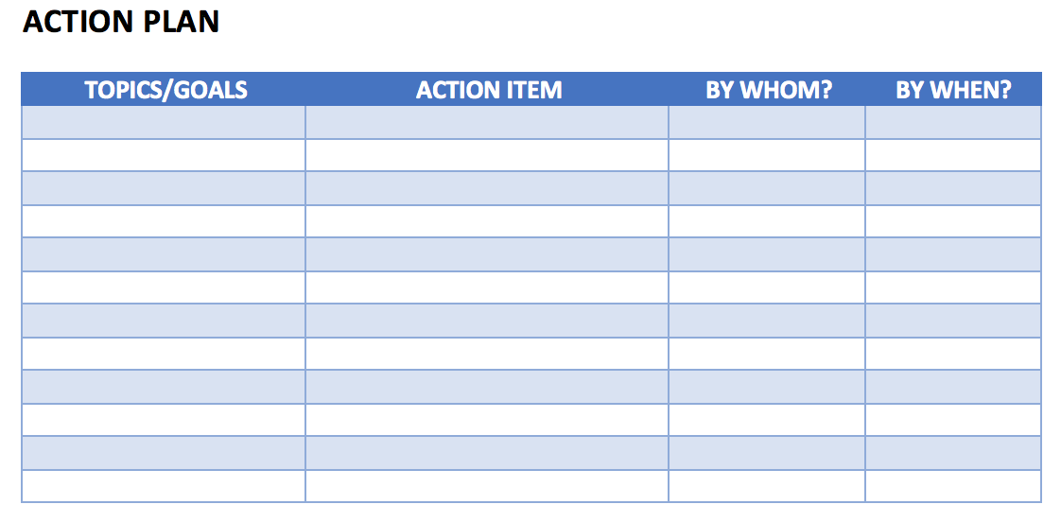
Action Plan
Action Plan – Share your action plan, if you have
any additional actions to complete

Slide 16
Deliverables
See / Understand the Process
  Process Map – Current State
  Identify (Brainstorm) Opportunities For Improvement (OFI)
  Prioritize (Impact-Effort Grid) OFI
Project Implementation
  Project Outline
    Problem Statement
    Aim Statement – Goal, Measure & Timeline
    Measure – Baseline Data, Data Collection Tool & Data Collection Plan
    Scope of Project
  Action Plan
Project Communication
  Elevator Speech

